Slide 1
pea 516
Lecture-8
Problems on trains

Slide 2
Contents:
Relative speed concept
Crossing a stationary and moving object

Slide 3
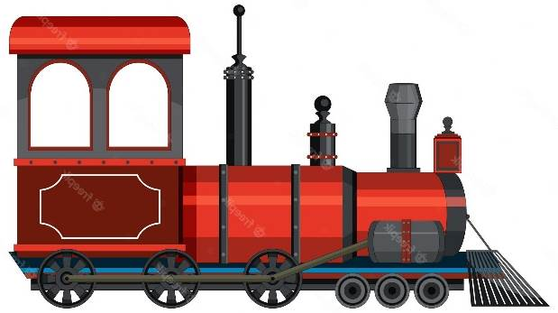
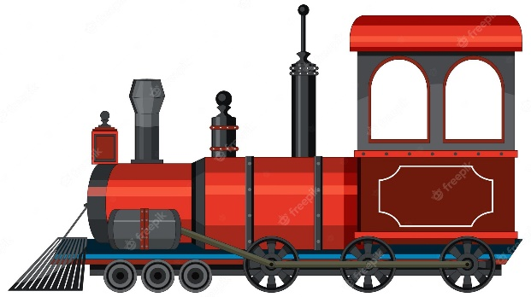
TRAINS
RELATIVE SPEED
S₁ S₂
RELATIVE SPEED
S_{R} = S₁ + S₂
(CROSSING)
S₁
S₁
RELATIVE SPEED
S_{R} = S₁ – S₂
S₂

Slide 4

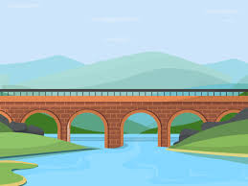
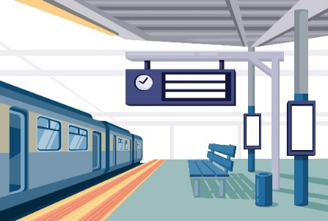
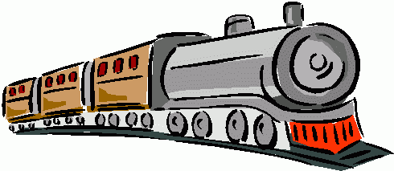

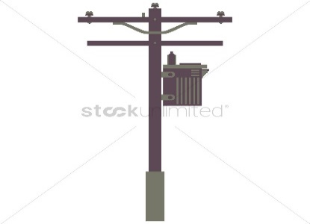

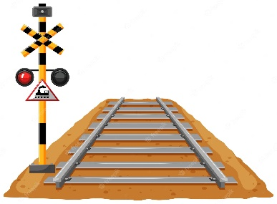
Point Object and Length Object
Length object:
Train Tunnel Bridge Platform
Point object:
Traffic signal Man Electric Pole Car

Slide 5
TRAIN PROBLEMS
Train problems broadly centre around the following three types.
L_{t}= Length of the train
S = Speed of the train
T = Time taken

Slide 6
1. Length object crossing the point object
Distance Travelled = Length of the train
Time taken(T) = L_{t} / S
2. Length object crossing the length object
Distance Travelled = Length of train + length of object
Time Taken = (L_{t} + SL )/ S
3. Length object crossing movable length object
Distance Travelled = Length of train + length of object Speed by which trains are moving = Relative Speed(S_{R})
Time Taken = (L_{t1} + L_{t2} )/S_{R}

Slide 7
1) A train passes a station platform in 36 seconds and a man standing on the platform in 20 seconds. If the speed of the train is 54 km/hr, then what is the length of the platform?
200 m
240 m
300 m
864 m

Slide 8
2) Two trains are running In opposite direction with the same speed. If the length of each train is 135 meters and they cross each other in 18 seconds, the speed of each train is
29 km/hr
35 km/hr
27 km/hr
54 km/hr

Slide 9
3) Two trains of lengths 210m and 180m respectively are running in opposite directions on parallel tracks. If their speeds be 50km/h and 58km/h respectively, in what time will they cross each other?
a) 22sec
b) 15sec
c) 30sec
d) 13sec

Slide 10
4) A train travelling at 42 km/h passes a runner in 9 seconds running in same direction and took 5 seconds in the opposite direction. Find the length of the train.
75 m
100 m
84 m
90 m
Notes:
Ans: 92.86 miles/hour

Slide 11
5) Two trains start at the same time from Aligarh to Delhi and proceed towards each other at the rate of 14km/h and 21km/h respectively and meet each other when one has travelled 70 km more than the other. The distance between the two stations is
a. 350km
b) 210km
c) 300km
d) 140km

Slide 12
6) A policeman starts chasing a thief who is 250 metres ahead of the policeman. If the policeman was able to catch the thief in 15 minutes and the speed of the thief is 8 km/h, find the distance travelled (in kilometres) by the policeman in 15 minutes.
1.5 km
2 km
2.25 km
2.5 km

Slide 13
7) A man standing on a railway platform notices that a train going in one direction takes 10 seconds to pass him and other train of the same length takes 15 seconds to pass him. Find the time taken by the two trains to cross each other when they are running in the opposite direction (all in seconds).
12
14
13.5
15

Slide 14
8) A jogger running at 9 km/hr along side a railway track is 260 m ahead of the engine of a 140 m long train running at 45 km/hr in the same direction. In how much time will the train pass the jogger ?
A) 25 sec
B) 40 sec
C) 38 sec
D) 32 sec

Slide 15
9) A car travelling in fog passed a man walking at 3 km/h in the same direction. He could see the car for 4 minutes and up to a distance of 100 m. What is the speed of the car (all in km/h)?
40.5
4.5
1.5
5.5

Slide 16
10) A car travelled a distance of 600 km in 6 hours. The first part of the journey is covered with a speed of 70 km/h and the rest of the journey is covered with the speed of 120 km/h. The distance covered in the first part of the journey is
240 km
120 km
168 km
None of these

Slide 17
11) Two trains of length 115 m and 110 m respectively run on parallel rails. When running in the same direction, the faster train passes the slower one in 25 seconds, but when they are running in opposite directions with the same speeds as earlier, they pass each other in 5 seconds. Find the speed of the faster train.
27 m/s
18 m/s
36 m/s
None of these

Slide 18
12) Two men start travelling in the opposite direction up to a point where the other started. If they take 13 minutes and 52 minutes respectively to reach the other end, after how much time (all in minutes) would they have met?
39
10.4
26
Cannot say

Slide 19
13) Two trains are running on a parallel line in same direction at a speed of 50 kmph and 30 kmph respectively. Given that the faster train crosses a man in the slower train in 18 sec, what is the length of the faster train?
a. 80 m
b. 92 m
c. 100 m
d. 120 m

Slide 20


